Slide 1
Potential for Blockchain-based Innovations in a Post-COVID World
Department of Innovation, Science and Economic Development, Government of Canada

Slide 2
Context
COVID-19 has surfaced the risk of relying on in-person and paper based processes to conduct transactions.
Governments and organizations that rely largely on these processes have been either unable to or delayed in delivering services.
In the post-COVID world, individuals and businesses will likely expect faster responses from governments and organizations, and want to transact digitally across the economy.

Slide 3
Trust and Blockchain
The essential part of any transaction is trust, or in other words, being assured that any claim made by a transacting party is true.
Government is a trust anchor in society and facilitates trust in society and the economy through various means, such as issuing individual and business identity, licences and permits and making information publicly available to support the public good.
Governments can enable trust online by providing digital versions of these documents, that could be verified through Blockchain, to support the COVID-19 response and enable a digital society.

Slide 4
Key Priorities
Digital Economy
COVID-19 Response
Digital and Open Society
Digital Credentials (Identity, licences and permits, claims)
Digital Infrastructure, enabled by Blockchain

Slide 5
Potential High-level Use Cases
Responding to COVID-19
Supporting re-opening of businesses (e.g., start or close operations as warranted by the health crisis).
Supporting movement of individuals and businesses providing “essential” goods and services across provincial and national borders (e.g., activities deemed to be essential).
Supporting return to work (e.g., proof of vaccination or negative testing result for to COVID-19)
Enabling a digital economy
Easing regulatory compliance by making it quicker and easier for individuals and businesses to prove their authority to conduct activities (e.g., liquor licence) and comply with regulations (e.g., Know Your Clients (KYC), Anti-Money Laundering (AML))
Facilitating trading of goods and services across international borders (e.g., import licences)
Identifying proof of origin and verifying product claims (e.g., environmental and social criteria)
Facilitating individual-to-business and business-to-business digital transactions.
Supporting a Digital and Open Society
Establishing digital identity for individuals and businesses (e.g., identity, qualifications)
Enabling international travel (e.g., digital passports)
Making it quicker and easier to obtain social and economic benefits from governments (e.g., auto-completing applications and real-time validation)
Supporting transparency (e.g., government contracts)

Slide 6
Sample Use Case 1: Opening a Bank Account
Transactions with governments and other businesses (e.g. banks) can be costly and time-consuming for SMEs.
Many of the transactions involve slow and manual processes with the added burden of paper-based documents.
Verifying the authenticity of paper-based documents and manually-inputted information is costly and time-consuming for service providers.
Makes it challenging for service providers to meet Canadian KYC and AML requirements.

Slide 7

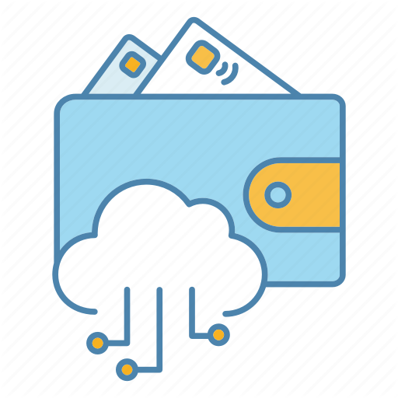



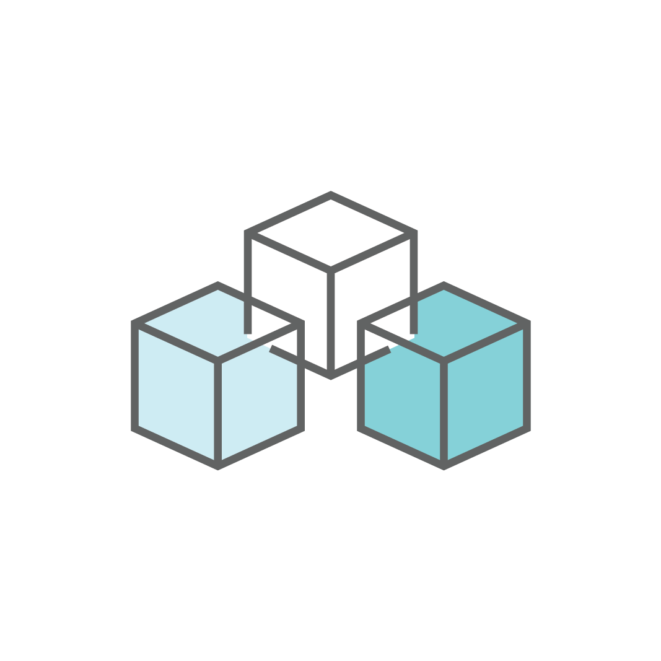
Sample Use Case 1: Opening a Bank Account (concept diagram under development)
We used your provincial digital credential to verify your identity, incorporate your business federally and then register in your province.
We used your provincial and federal digital credentials to verify you and your corporation and to open your new bank account.
I want to incorporate my business federally and operate in my province.
I want to open a bank account for my new federal corporation.
Thank you for making this quick and easy so I can focus more on my business.
Shares provincial individual digital credential and provides registration information.
Issues business digital credentials
Shares individual and business digital credentials
Issues bank account digital credentials
Digital
Wallet
Business Owner
Corporations Canada and provincial corporate registry
Business Owner
Bank Representative
Business Owner
Digital Credentials (previously issued)
Verifies authenticity of the information and the issuer
Credential Issuers
(i.e., provincial issuer)
Writes information used to verify the authenticity of the information and the issuer
Client information is stored in the client’s digital wallet, not on the Blockchain
Blockchain
Businesses save time when transacting with government and other businesses

Slide 8
Sample Use Case 2: Natural Gas Sold Directly
A federally incorporated natural gas operator in B.C. wants to sell natural gas in California.
Potential purchasers in California only want to buy gas that meets or exceeds Environmental, Social and Governance (ESG) benchmarks.
In addition, U.S. Customs and Border Protection wants to know the point of origin and purchaser/destination of any goods entering the U.S. to determine what (if any) tariffs to apply.
Engaging in cross-border trade can be costly and time-consuming for SMEs and government entities, often requiring businesses to provide paper-based documents.

Slide 9

Sample Use Case 2: Natural Gas Sold Directly (concept diagram under development)
I want to purchase natural gas
that exceeds global ESG benchmarks. Your product meets our needs.
Terms are in the Gas Purchase Agreement (GPA).
We can transport the
natural gas on our pipeline system.
Terms are in the Firm Transportation Service Agreement (FTSA).
I want to receive
the natural gas that
was purchased.
I want to sell
natural gas in the U.S.
I need to transport the natural gas to the purchaser.
Shares digital credentials (e.g., identity, ESG ratings, point of origin, export licence)
Shares digital credentials
(e.g., Identity, export licence, GPA)
Shares digital credentials
(e.g., Identity, operating
licence, GPA)
Issues GPA
credential
Digital
Wallet
Issues FTSA credential
Issues FTSA credential and provides access to the natural gas
Canadian Natural Gas Producer & Seller
U.S. Natural Gas
Purchaser
Natural Gas Transporter
(Pipeline Owner)
Shares digital credentials for reporting (e.g., identity, GPA,
export licence)
Shares digital credentials for tariffs and reporting (e.g., point of origin, GPA, FTSA)
Credential Issuers
(e.g., Provincial Government,
Corporations Canada, ESG Assessment Entity,
Canada Energy Regulator)
Credential issuers
(e.g., State-Level Public Utilities Regulator, Department of Energy)
Canadian Regulatory Credential Consumers (e.g., CER, CBSA, provincial regulator)
U.S. Regulatory Credential Consumers (e.g., CBP, FERC)
Issuers write information to a Blockchain to verify the authenticity of the information and the issuer
Consumers use the Blockchain to verify authenticity of the credential and the issuer
Client information is stored in the client’s digital wallet, not on the Blockchain
Blockchain
Selling and Exporting Natural Gas to the United States

Slide 10
Key Issues facing Blockchain-based Innovations
Technology Maturity: Identifying the approach to assess and conduct due diligence on the digital Iinfrastructure and relying applications*.
Ecosystem: Identify approaches to establish an ecosystem of issuers and consumers
Governance: Identifying stakeholders to govern the infrastructure and relying applications.
Interoperability: Developing standards to ensure interoperability between digital infrastructure technologies, relying applications and legacy systems.
Security and Privacy: Approaches to ensuring ongoing security and protection of privacy.
Operations: Whether the digital infrastructure and relying applications should be operated by government, by the private sector or jointly.
Education and Training: Approaches to ensuring sufficient skill-sets and capacity within government.
International Cooperation: Identifying opportunities for collaboration with other countries and international fora on digital infrastructure and relying applications.
Policy and Regulatory Alignment: Identifying the policy or regulatory alignment that could be required.
Action Plan: Proposing an action plan to support establishment of the digital infrastructure.
* relying applications refers to solutions built on blockchain such as Digital Credentials, held in Digital Wallets and public repositories.

Slide 11
Open Discussion
How are you approaching blockchain-based innovations?
Role of Government in establishing Digital Infrastructure, enabled by Blockchain
Welcome your thoughts on how to kick-start the ecosystem
Opportunities for collaboration

Slide 12
Annex: Pan-Canadian Trust Framework (PCTF)
PCTF is a set of criteria and specifications to ensure jurisdictions abide by a common, agreed-upon set of rules to trust and accept each other’s digital identities
The focus is Digital Identity to enable Canadians (i.e., individuals and businesses) to have a trusted, streamlined, and secure way of transacting in a digital economy
Benefits – improve trust and efficiency, while reducing fraud
Guiding principles supporting the PCTF development
Privacy and security respected
Convenience and choice for citizen sharing identity information
“Economic opportunities conservatively estimated at $15+ Billion (1% of GDP) if Trusted Digital Identity is enabled in Canada”
(Digital Identification and Authentication Council of Canada CIOSC Presentation Nov. 2018)

